Slide 1


IS FLY REALLY SAFER THAN DRIVING?
By : Yousof rahimian

Slide 2
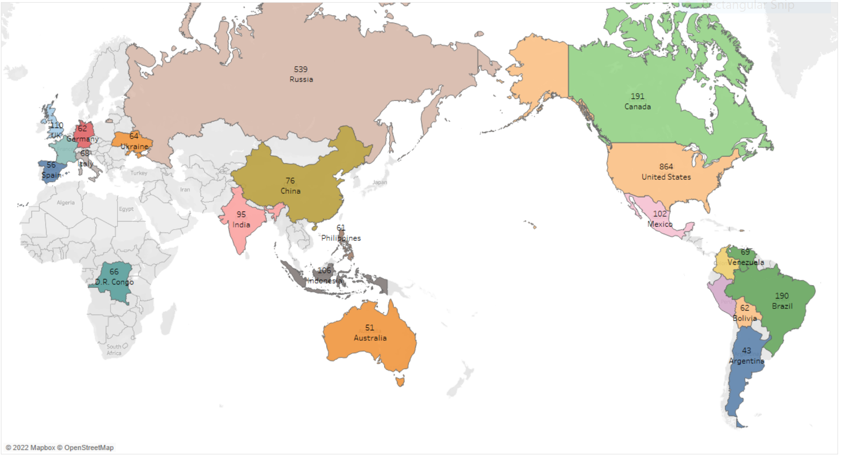
Countries with highest number of fatal civil airliner accidents from 1945 to 2022 North America: 1157 United State: 864

Slide 3
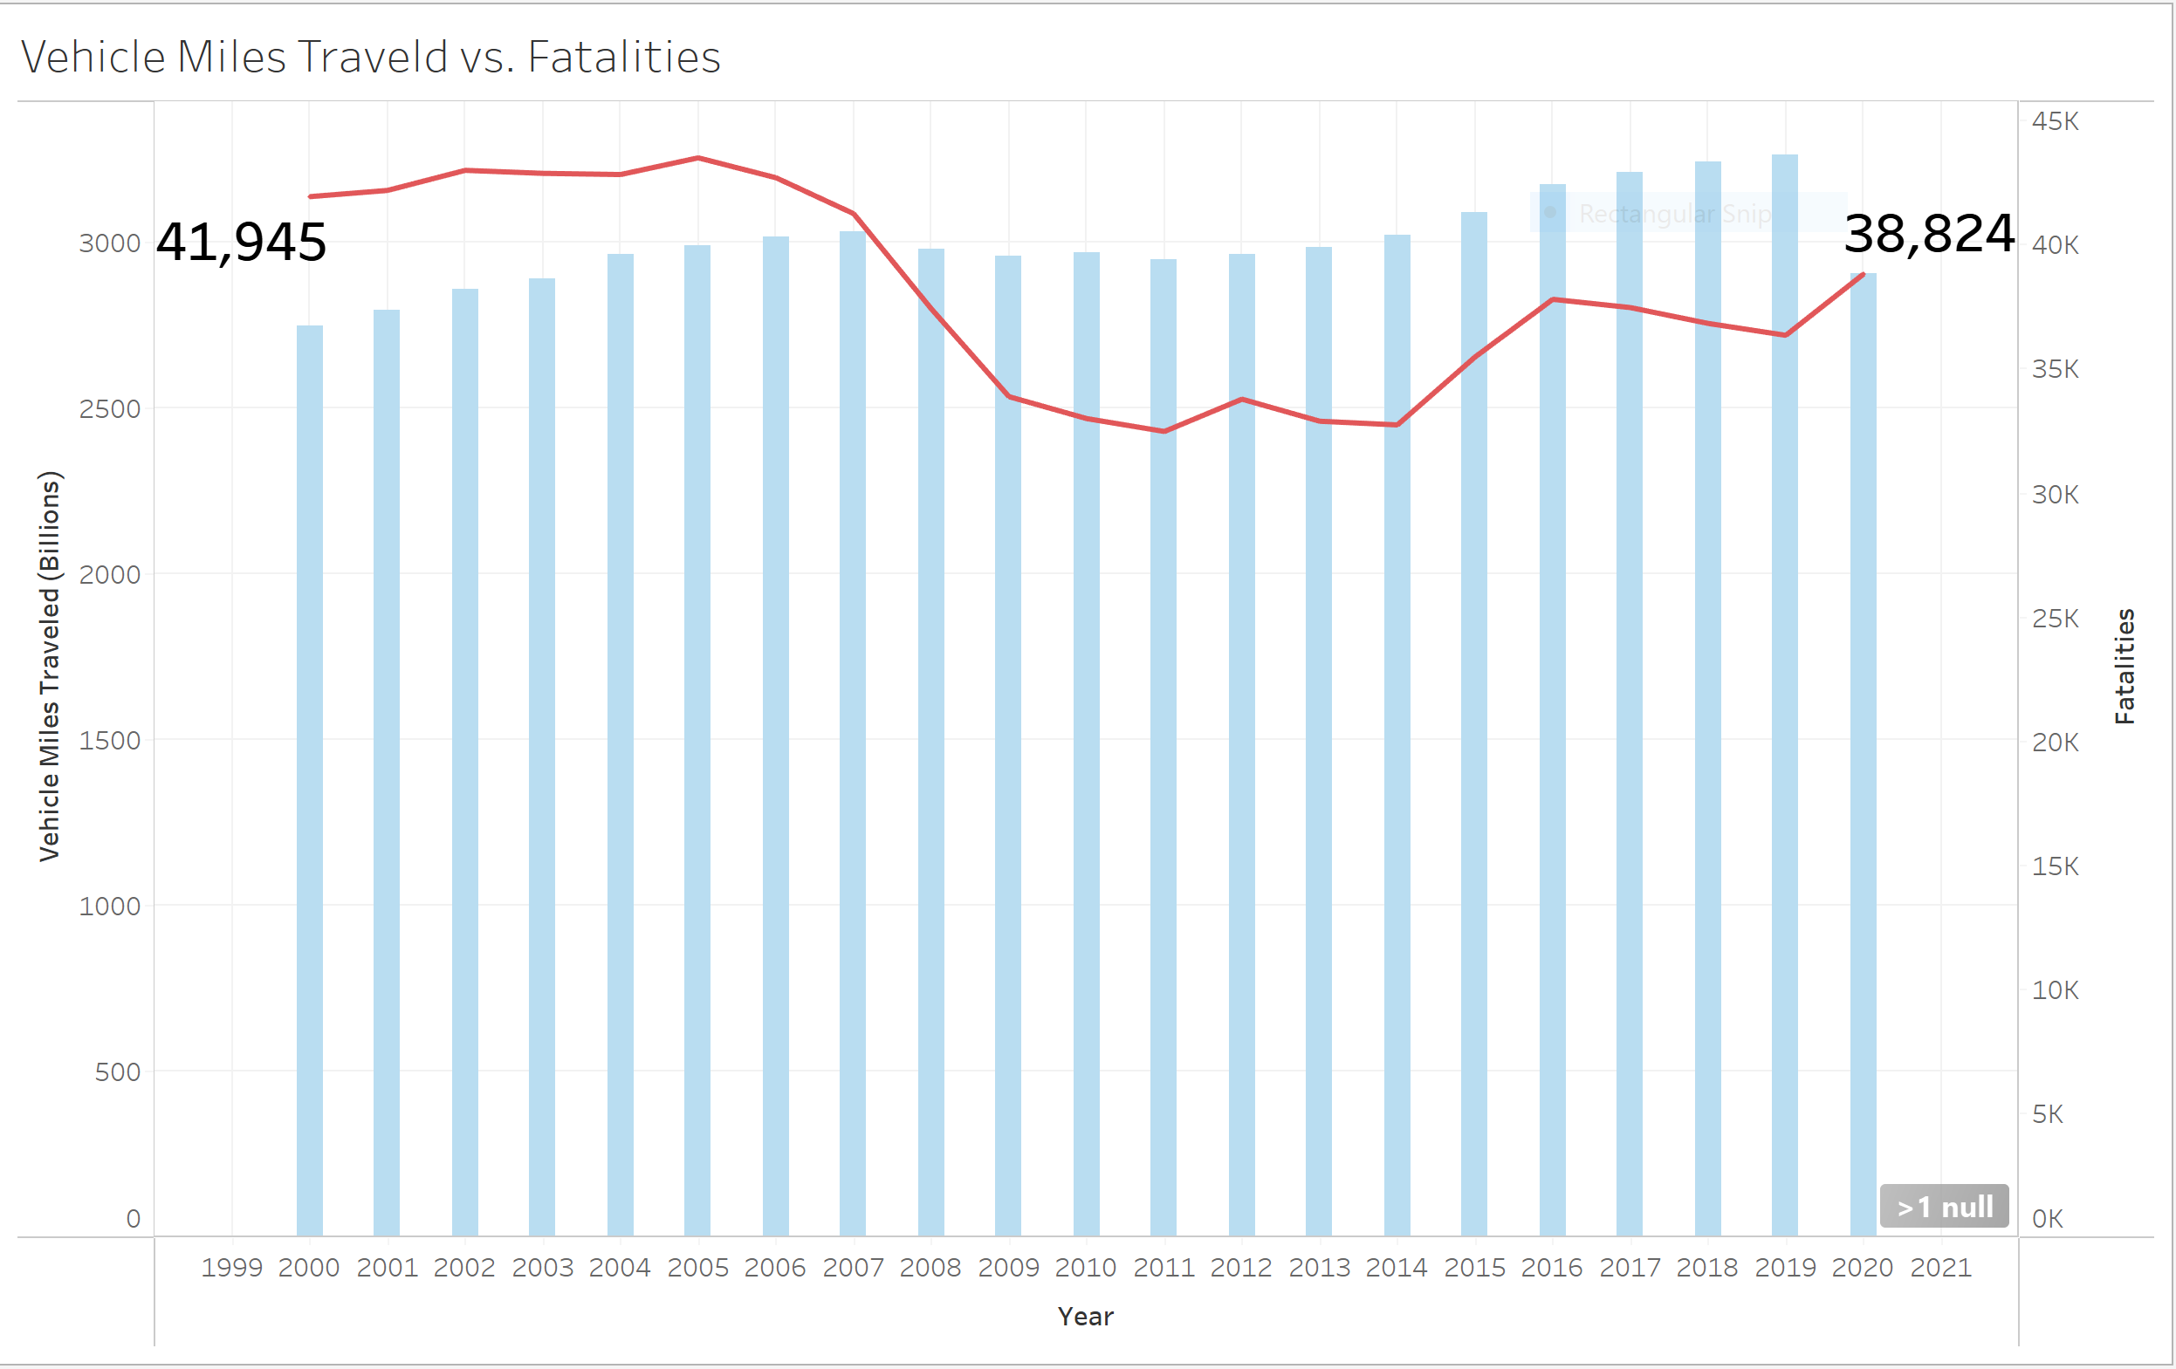
Vehicles Miles Travels vs. Fatalities

Slide 4
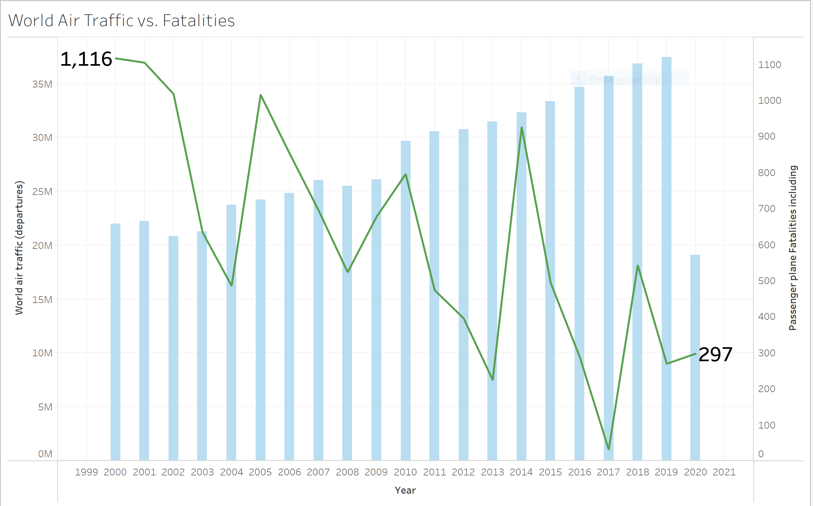
World Air Traffic vs. Fatalities From 2000 to2020

Slide 5
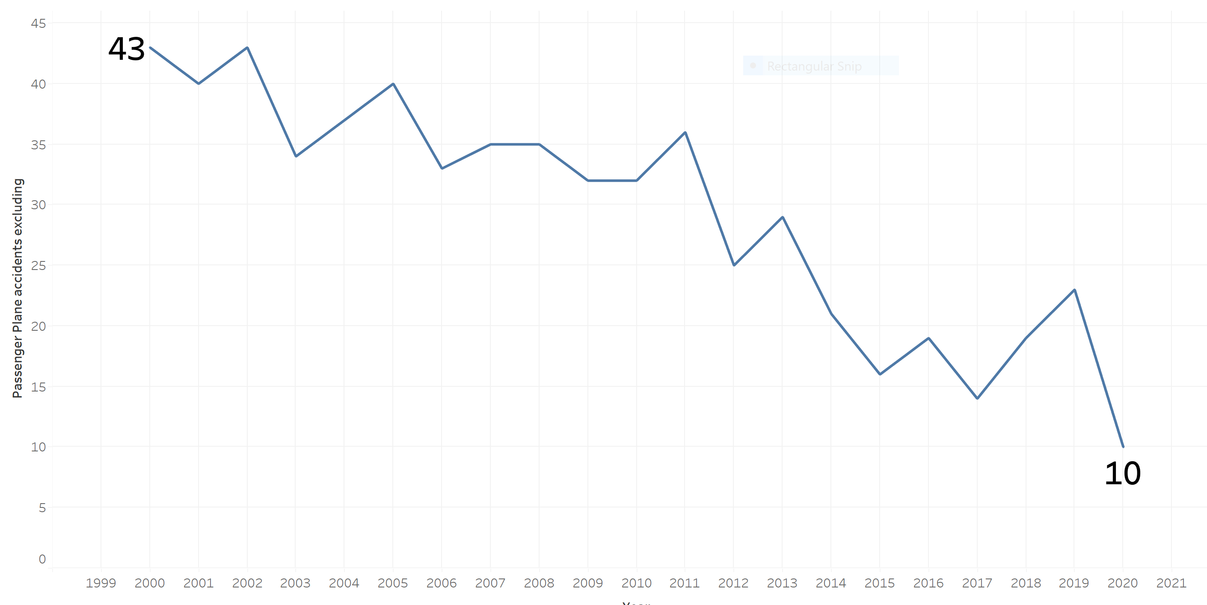
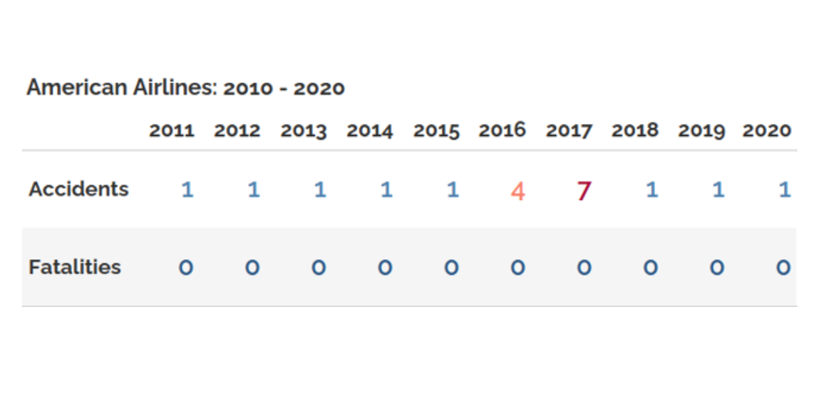
American Airline Accident & Fatalities 2010 –2020

Slide 6
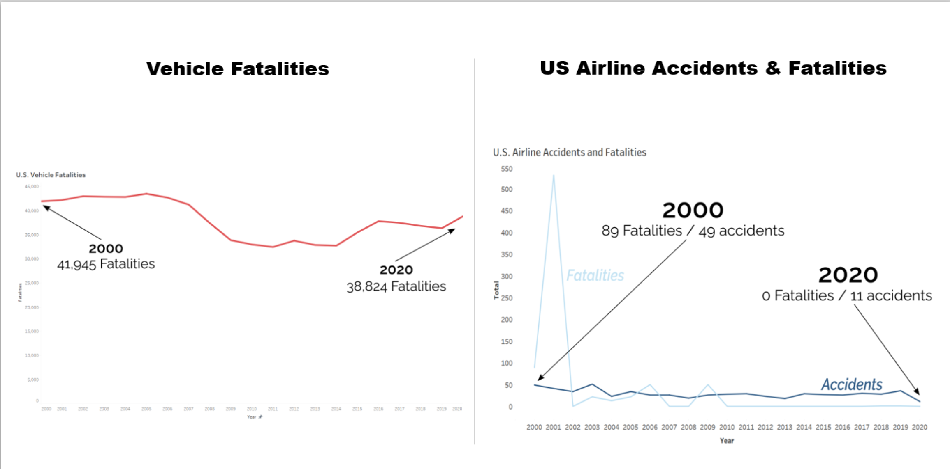
Vehicle Fatalities Vs. US Airline Accident & Fatalities

Slide 7
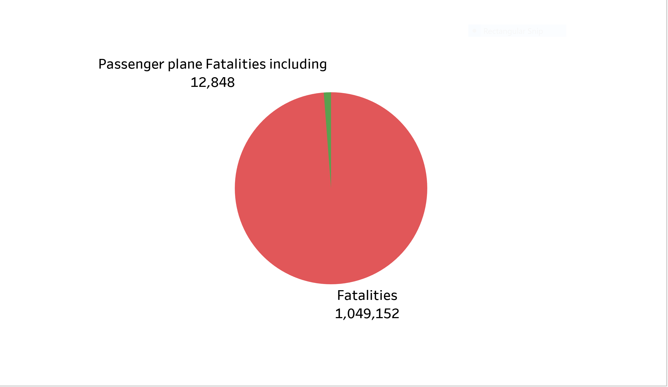
Vehicle Fatalities vs. Passenger Plane Fatalities (2000 – 2020)
Vehicle Fatalities from 2000 to 2022

